Slide 1



Smart Speaker using ai and ml

Slide 2
Group : ETA16
Amey Muley 60
Sahil Dalvi 53
Deepak Adhayake 48

Slide 3
Introduction
Smart speaker is project about converting a normal speaker into a smart Ai enables assistant which will enhance daily life activities.
By only giving voice commands it carries out different operations based on user’s desires.
It fulfils services like whether info , internet surfing, IoT enabled devices and much more by using simple voice commands.
Artificial intelligence and machine learning algorithms provides an edge to make humans life more efficient.

Slide 4
Problem statements
In the era of rapid technological advancements, smart speakers powered by AI assistants have become an integral part of our daily lives.
However, as we embrace these innovative devices, a number of pressing issues and challenges have emerged, impacting both users and society at large.
This presentation aims to shed light on these critical problems and provoke discussions on how to address them effectively.

Slide 5

Objectives
Enhance
Enhance User Convenience
To make daily tasks more convenient for users by providing voice-activated access to information, services, and smart home controls.
Improve
Improve Efficiency
To increase productivity and save time for users by executing tasks quickly and efficiently through voice commands.
Enable
Enable Natural Language Interaction
To create AI-powered assistants that can understand and respond to natural language, making human-computer interaction more intuitive.
Personalize
Personalize User Experience
To use AI to customize responses and recommendations based on individual user preferences and habits.
Support
Support Smart Home Integration
To seamlessly integrate with smart home devices and enable users to control lighting, heating, security, and other IoT devices.

Slide 6




Software & hardware Requirement
VS Code Studio
Api and
packages
Speech Recognition Models
USB Mic
Wireless Speaker
Connectivity
Execution
Power Supply

Slide 7
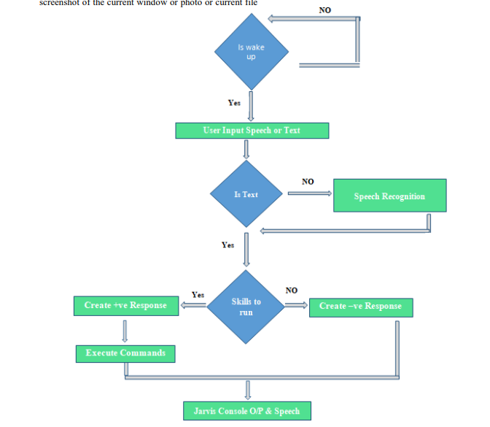
Flowchart

Slide 8
References
Links
https://scientificoder.blogspot.com/2022/05/jarvis-in-one-video.html
https://www.youtube.com/watch?v=rgGDTO8g2Pg
P. Mehrotra, et al. "Smart Speakers: A New and Intelligent Way to Interact with the House." IEEE Pervasive Computing.

Slide 9
Thank you

